Slide 1
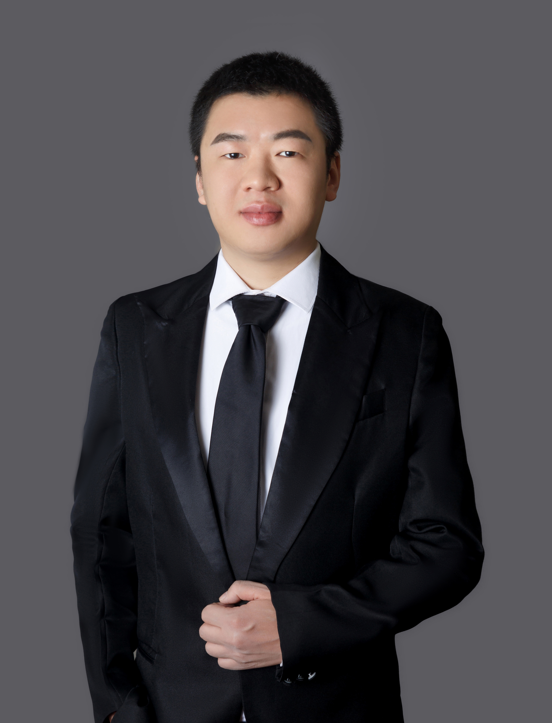

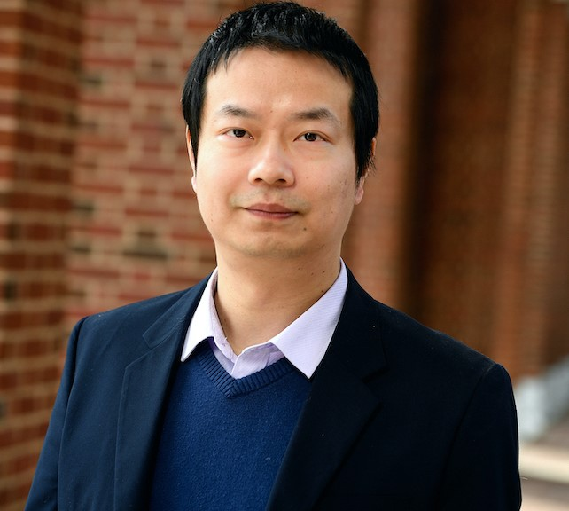
Explicit Min-wise Hash Families with Optimal Size
Xue Chen*
Shengtang Huang*
Xin Li†
* University of Science and Technology of China
† Johns Hopkins University

Slide 2
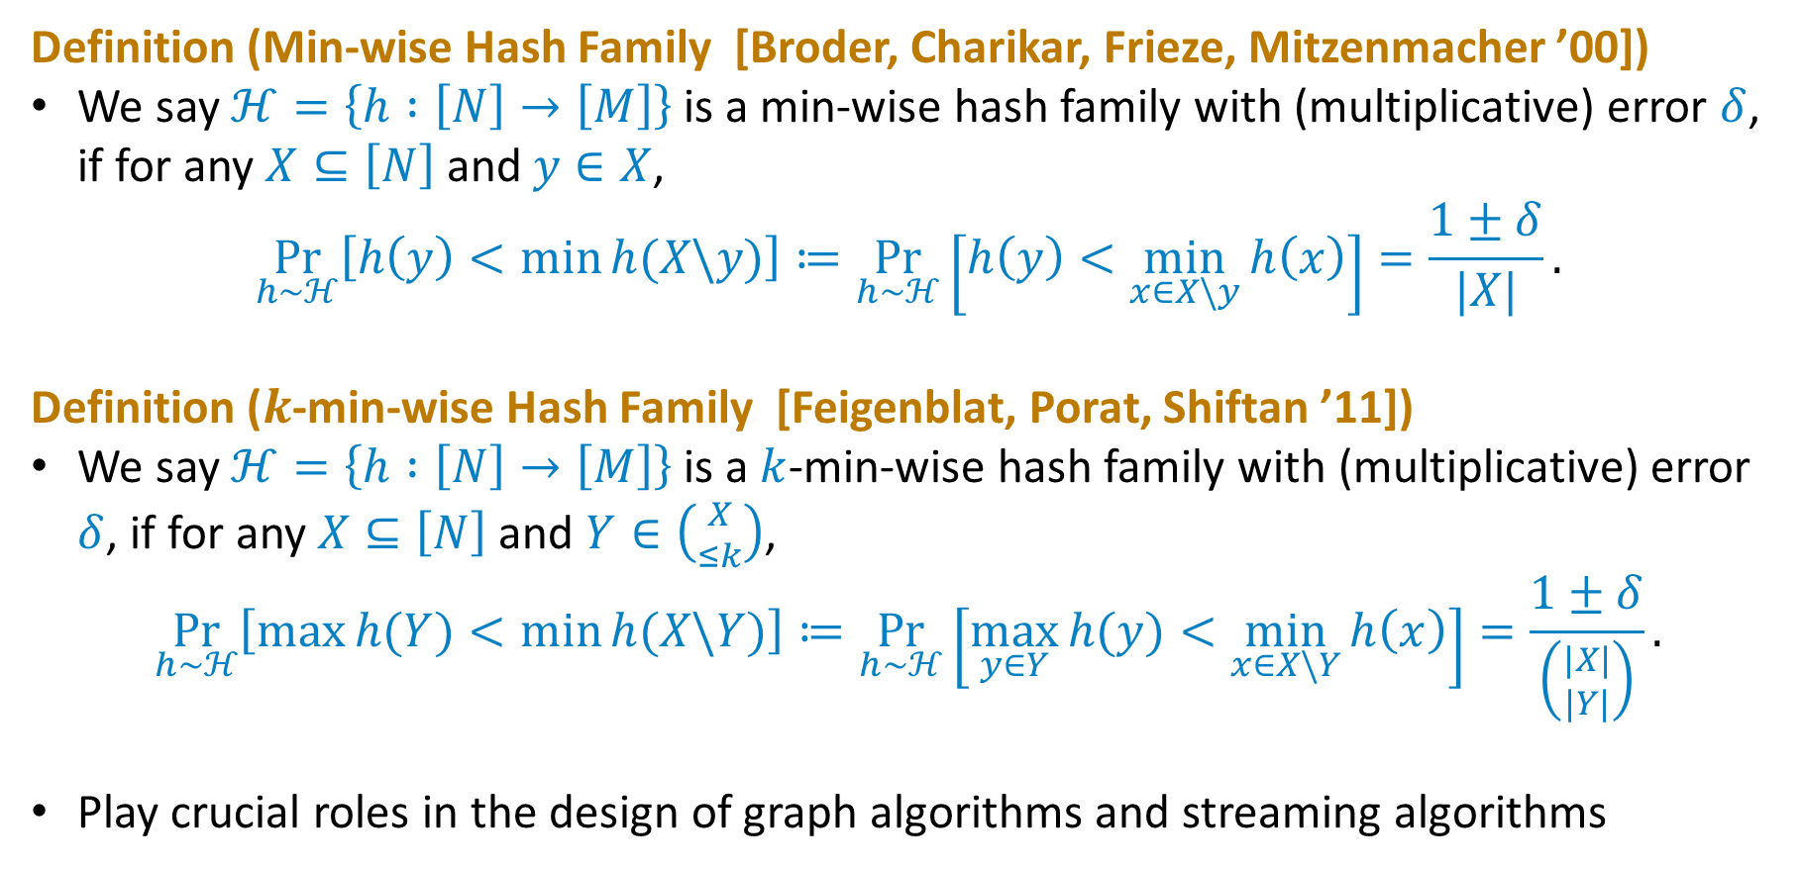
Min-wise Hash Family
Definition (Min-wise Hash Family [Broder, Charikar, Frieze, Mitzenmacher ’00])
We say $ℋ=\left\{h :\left[N\right]→\left[M\right]\right\}$ is a min-wise hash family with (multiplicative) error $δ$, if for any $X⊆\left[N\right]$ and $y∈X$,
$$\underset{h∼ℋ}{Pr}\left[h\left(y\right)<\min{h(X\backslash y)}\right]≔\underset{h∼ℋ}{Pr}\left[h\left(y\right)<\min_{x∈X\backslash y}{h\left(x\right)}\right]=\frac{1±δ}{|X|}.$$
Definition ($k$-min-wise Hash Family [Feigenblat, Porat, Shiftan ’11])
We say $ℋ=\left\{h :\left[N\right]→\left[M\right]\right\}$ is a $k$-min-wise hash family with (multiplicative) error $δ$, if for any $X⊆\left[N\right]$ and $Y∈\left({X \atop ≤k}\right)$,
$$\underset{h∼ℋ}{Pr}\left[\max{h(Y)}<\min{h(X\backslash Y)}\right]≔\underset{h∼ℋ}{Pr}\left[\max_{y∈Y}{h(y)}<\min_{x∈X\backslash Y}{h\left(x\right)}\right]=\frac{1±δ}{\left({|X| \atop |Y|}\right)}.$$
Play crucial roles in the design of graph algorithms and streaming algorithms

Slide 3
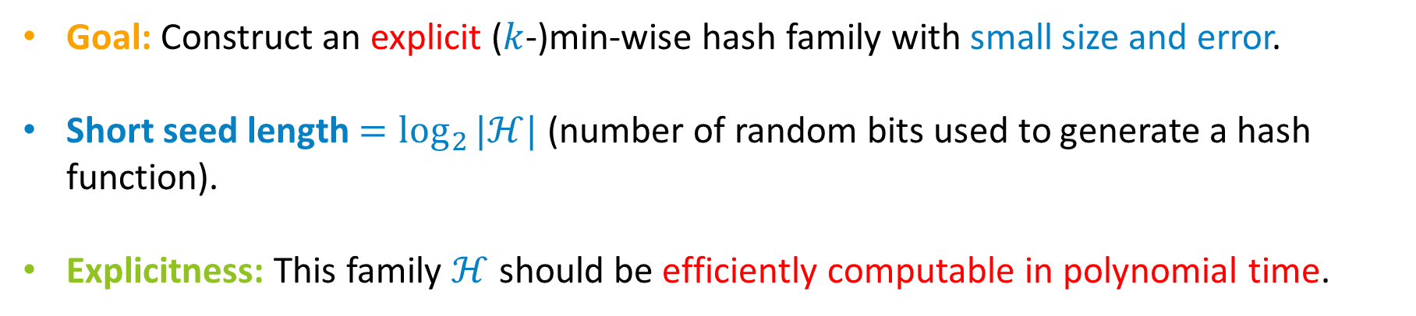
Problem
Goal: Construct an explicit ($k$-)min-wise hash family with small size and error.
Short seed length $=\log_{2}{|ℋ|}$ (number of random bits used to generate a hash function).
Explicitness: This family $ℋ$ should be efficiently computable in polynomial time.

Slide 4
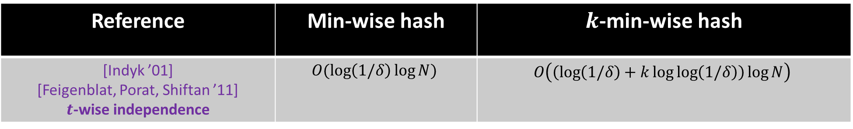
Prior Works
Reference | Min-wise hash | $k$-min-wise hash
[Indyk ’01] [Feigenblat, Porat, Shiftan ’11] $t$-wise independence | $$O(\log\left(1/δ\right)\log{N})$$ | $$O\left(\left(\log\left(1/δ\right)+k\log{\log\left(1/δ\right)}\right)\log{N}\right)$$

Slide 5
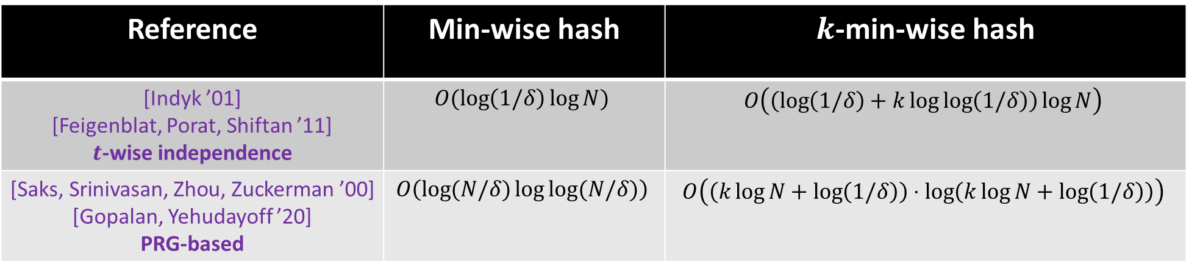
Prior Works
Reference | Min-wise hash | $k$-min-wise hash
[Indyk ’01] [Feigenblat, Porat, Shiftan ’11] $t$-wise independence | $$O(\log\left(1/δ\right)\log{N})$$ | $$O\left(\left(\log\left(1/δ\right)+k\log{\log\left(1/δ\right)}\right)\log{N}\right)$$
[Saks, Srinivasan, Zhou, Zuckerman ’00] [Gopalan, Yehudayoff ’20] PRG-based | $$O\left(\log{(N/δ)}\log{\log{(N/δ)}}\right)$$ | $$O\left(\left(k\log{N}+\log\left(1/δ\right)\right)⋅\log\left(k\log{N}+\log\left(1/δ\right)\right)\right)$$

Slide 6
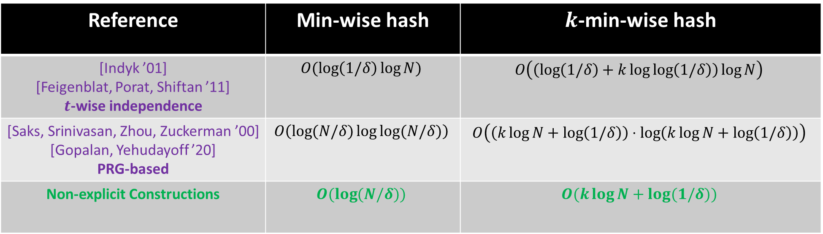
Prior Works
Reference | Min-wise hash | $k$-min-wise hash
[Indyk ’01] [Feigenblat, Porat, Shiftan ’11] $t$-wise independence | $$O(\log\left(1/δ\right)\log{N})$$ | $$O\left(\left(\log\left(1/δ\right)+k\log{\log\left(1/δ\right)}\right)\log{N}\right)$$
[Saks, Srinivasan, Zhou, Zuckerman ’00] [Gopalan, Yehudayoff ’20] PRG-based | $$O\left(\log{(N/δ)}\log{\log{(N/δ)}}\right)$$ | $$O\left(\left(k\log{N}+\log\left(1/δ\right)\right)⋅\log\left(k\log{N}+\log\left(1/δ\right)\right)\right)$$
Non-explicit Constructions | $$O(\log{(N/δ)})$$ | $$O(k\log{N}+\log{(1/δ)})$$

Slide 7
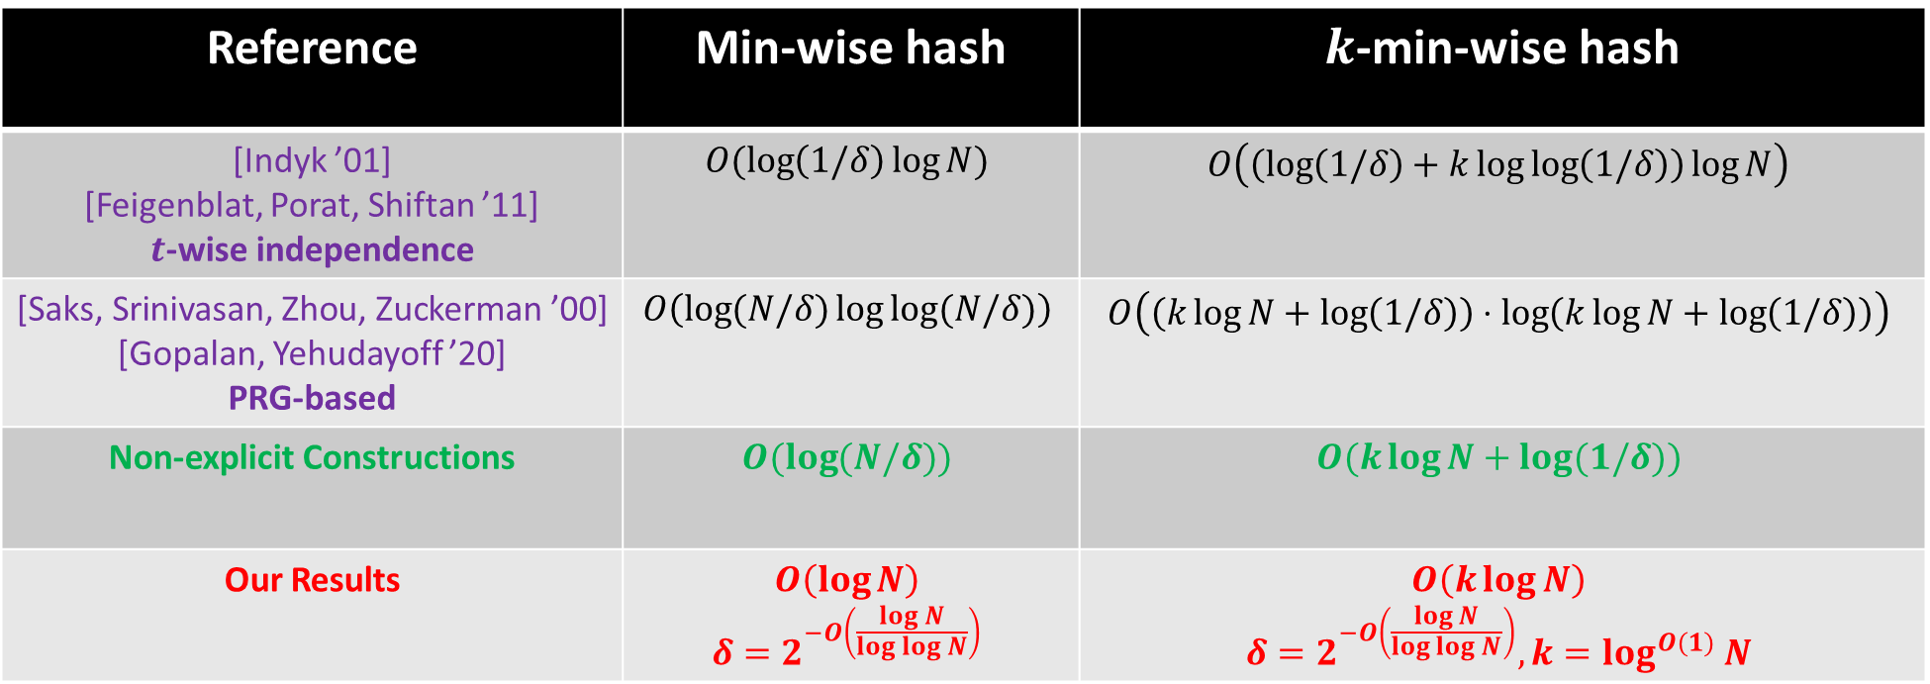
Our Results
Reference | Min-wise hash | $k$-min-wise hash
[Indyk ’01] [Feigenblat, Porat, Shiftan ’11] $t$-wise independence | $$O(\log\left(1/δ\right)\log{N})$$ | $$O\left(\left(\log\left(1/δ\right)+k\log{\log\left(1/δ\right)}\right)\log{N}\right)$$
[Saks, Srinivasan, Zhou, Zuckerman ’00] [Gopalan, Yehudayoff ’20] PRG-based | $$O\left(\log{(N/δ)}\log{\log{(N/δ)}}\right)$$ | $$O\left(\left(k\log{N}+\log\left(1/δ\right)\right)⋅\log\left(k\log{N}+\log\left(1/δ\right)\right)\right)$$
Non-explicit Constructions | $$O(\log{(N/δ)})$$ | $$O(k\log{N}+\log{(1/δ)})$$
Our Results | $$O\left(\log{N}\right)$$ $$δ=2^{−O\left(\frac{\log{N}}{\log{\log{N}}}\right)}$$ | $$O\left(k\log{N}\right)$$ $$δ=2^{−O\left(\frac{\log{N}}{\log{\log{N}}}\right)}, k=\log^{O(1)}{N}$$

Slide 8
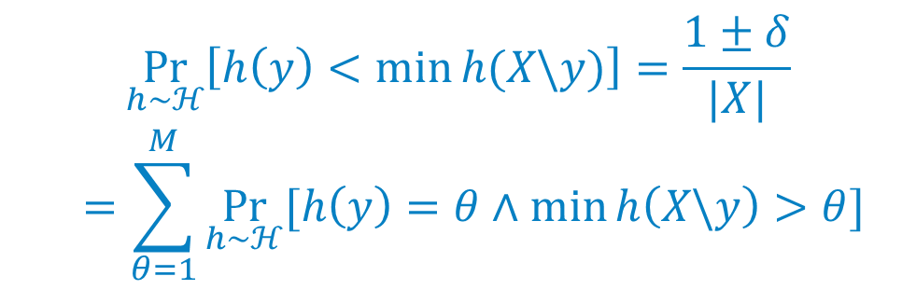
Outline
1st STEP – BALLS INTO BINS
$$\underset{h∼ℋ}{Pr}\left[h\left(y\right)<\min{h(X\backslash y)}\right]=\frac{1±δ}{|X|}$$
$$=\sum_{θ=1}^{M}{\underset{h∼ℋ}{Pr}{[h\left(y\right)=θ∧\min{h\left(X\backslash y\right)>θ}]}}$$
2nd STEP – RECYCLE RANDOMNESS
3rd STEP – DOMAIN REDUCTION

Slide 9

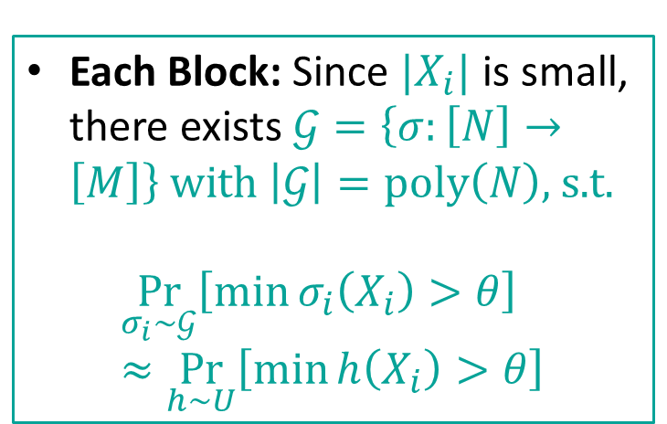


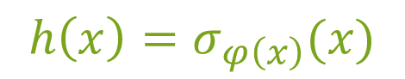
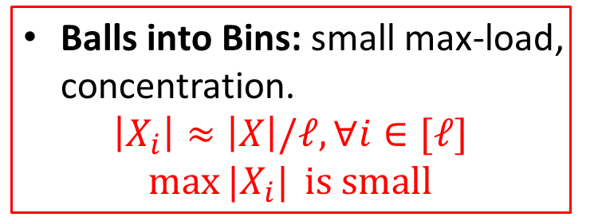

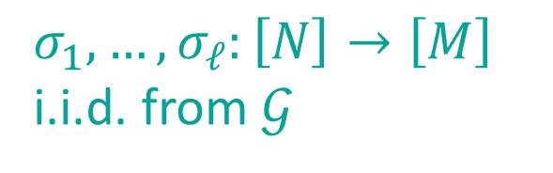
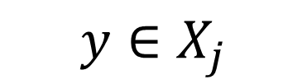

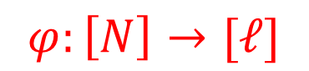

Two Level Hash Structure
$$h\left(x\right)=σ_{φ\left(x\right)}(x)$$
$$X$$
Balls into Bins: small max-load, concentration.
$$\left|X_{i}\right|≈\left|X\right|/ℓ, ∀i∈[ℓ]$$
$$\max{|X_{i}|} \text{is} \text{small}$$
$$φ:\left[N\right]→[ℓ]$$
Constant-wise independence
$$⋯$$
$$y∈X_{j}$$
$$⋯$$
$$X_{1}$$
$$X_{ℓ}$$
Each Block: Since $|X_{i}|$ is small, there exists $𝒢=\left\{σ:\left[N\right]→\left[M\right]\right\} \text{with} \left|𝒢\right|=\text{poly}\left(N\right)\text{, }\text{s}\text{.}\text{t}\text{.}$
$$\underset{σ_{i}∼𝒢}{Pr}\left[\min{σ_{i}\left(X_{i}\right)}>θ\right]≈\underset{h∼U}{Pr}\left[\min{h\left(X_{i}\right)}>θ\right]$$
$$σ_{1},…,σ_{ℓ}:\left[N\right]→\left[M\right]$$
i.i.d. from $𝒢$
$$[M]$$
Require many random bits.

Slide 10

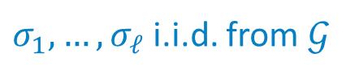




Recycle Randomness
$$\left(\min{σ_{1}\left(X_{1}\right)}>θ\right)∧⋯∧\left(σ_{j}(y)=θ∧\min{σ_{j}\left(X_{j}\backslash y\right)>θ}\right)∧⋯∧\left(\min{σ_{ℓ}\left(X_{ℓ}\right)}>θ\right)$$
$$\text{Ev}\text{ent} A_{1}$$
$$\text{Ev}\text{ent} A_{j}$$
$$\text{Event} A_{ℓ}$$
$σ_{1},…,σ_{ℓ}$ i.i.d. from $𝒢$
$$≈$$
$$\left(\min{σ_{1}^{′}\left(X_{1}\right)}>θ\right)∧⋯∧\left(σ_{j}^{′}(y)=θ∧\min{σ_{j}^{′}\left(X_{j}\backslash y\right)>θ}\right)∧⋯∧\left(\min{σ_{ℓ}^{′}\left(X_{ℓ}\right)}>θ\right)$$
$σ_{1}^{′},…,σ_{ℓ}^{′}$ are correlated

Slide 11

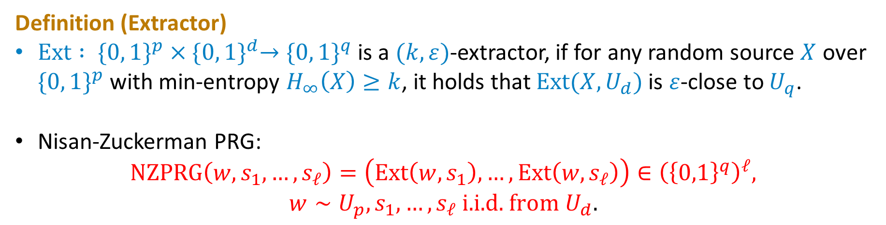


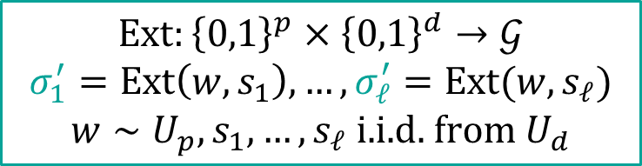
Nisan-Zuckerman Pseudorandom Generator
Definition (Extractor)
$\text{Ext} : \{0, 1\}^{p}×{\{0, 1\}}^{d}→{\{0, 1\}}^{q}$ is a $(k, ε)$-extractor, if for any random source $X$ over $\{0, 1\}^{p}$ with min-entropy $H_{∞}\left(X\right)≥k$, it holds that $\text{Ext}(X, U_{d})$ is $ε$-close to $U_{q}$.
Nisan-Zuckerman PRG:
$$\text{NZPRG}\left(w, s_{1},…,s_{ℓ}\right)=\left(\text{Ext}\left(w,s_{1}\right),…,\text{Ext}\left(w,s_{ℓ}\right)\right)∈{\left({\left\{0,1\right\}}^{q}\right)}^{ℓ},$$
$$w∼U_{p}, s_{1},…,s_{ℓ} \text{i}\text{.}\text{i}\text{.}\text{d}\text{.} \text{from} U_{d}.$$
$$\left(\min{σ_{1}^{′}\left(X_{1}\right)}>θ\right)∧⋯∧\left(σ_{j}^{′}(y)=θ∧\min{σ_{j}^{′}\left(X_{j}\backslash y\right)>θ}\right)∧⋯∧\left(\min{σ_{ℓ}^{′}\left(X_{ℓ}\right)}>θ\right)$$
$$\text{Ev}\text{ent} A_{1}$$
$$\text{Ev}\text{ent} A_{j}$$
$$\text{Event} A_{ℓ}$$
$$\text{Ext}:{\left\{0,1\right\}}^{p}×{\left\{0,1\right\}}^{d}→𝒢$$
$$σ_{1}^{′}=\text{Ext}\left(w,s_{1}\right),…,σ_{ℓ}^{′}=\text{Ext}(w,s_{ℓ})$$
$$w∼U_{p},s_{1},…,s_{ℓ} \text{i}\text{.}\text{i}\text{.}\text{d}\text{. }\text{from} U_{d}$$

Slide 12
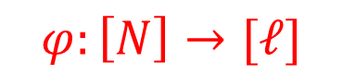
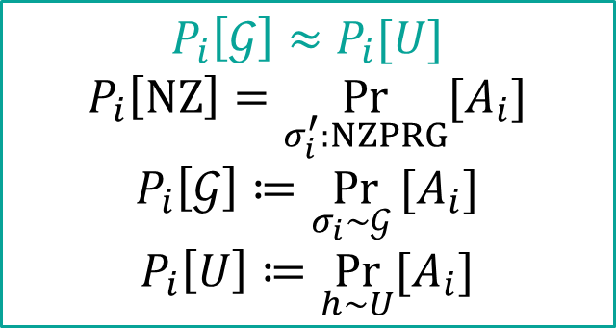

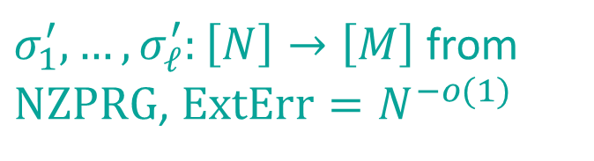


One bin is Sensitive to Multiplicative Error
$$h\left(x\right)=σ_{φ\left(x\right)}^{′}(x)$$
$$\underset{h∼ℋ}{Pr}{[h\left(y\right)=θ∧\min{h\left(X\backslash y\right)}>θ]}$$
$$=$$
$$φ:\left[N\right]→[ℓ]$$
$$P_{1}\left[\text{NZ}\right]⋯P_{j}\left[\text{NZ}\right]⋯P_{ℓ}\left[\text{NZ}\right]$$
$$P_{i}\left[𝒢\right]≈P_{i}[U]$$
$$P_{i}\left[\text{NZ}\right]=\underset{σ_{i}^{′}:NZPRG}{Pr}{[A_{i}]}$$
$$P_{i}\left[𝒢\right]≔\underset{σ_{i}∼𝒢 }{Pr}{[A_{i}]}$$
$$P_{i}\left[U\right]≔\underset{h∼U}{Pr}{[A_{i}]}$$
$σ_{1}^{′},…,σ_{ℓ}^{′}:\left[N\right]→\left[M\right]$ from $\text{NZPRG}$, $\text{ExtErr}=N^{−o(1)}$
$$≈$$
We hope that this special bin does not need to pay for the error from extractor.
$$\left(P_{1}\left[U\right]±\text{ExtErr}\right)⋯\left(P_{j}\left[U\right]±\text{ExtErr}\right)⋯\left(P_{ℓ}\left[U\right]±\text{ExtErr}\right)$$
$$P_{j}\left[U\right]=\underset{h∼U}{Pr}\left[h\left(y\right)=θ∧\min{h\left(X_{j}\backslash y\right)>θ}\right]≤1/M ⟹P_{j}\left[U\right]±\text{ExtErr}=P_{j}\left[U\right]⋅(1±M⋅\text{ExtErr})$$
$P_{j}[U]$ is very small, and it makes this bin very sensitive to multiplicative error.

Slide 13

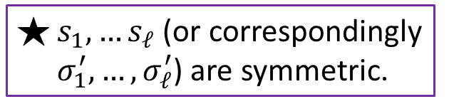

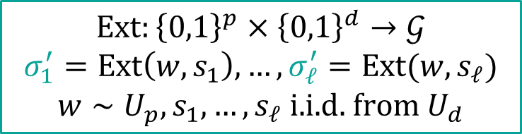

Change the Order of Inputs
$$\left(\min{σ_{1}^{′}\left(X_{1}\right)}>θ\right)∧⋯∧\left(σ_{j}^{′}(y)=θ∧\min{σ_{j}^{′}\left(X_{j}\backslash y\right)>θ}\right)∧⋯∧\left(\min{σ_{ℓ}^{′}\left(X_{ℓ}\right)}>θ\right)$$
$$\text{Ev}\text{ent} A_{1}$$
$$\text{Ev}\text{ent} A_{j}$$
$$\text{Event} A_{ℓ}$$
$$\text{Ext}:{\left\{0,1\right\}}^{p}×{\left\{0,1\right\}}^{d}→𝒢$$
$$σ_{1}^{′}=\text{Ext}\left(w,s_{1}\right),…,σ_{ℓ}^{′}=\text{Ext}(w,s_{ℓ})$$
$$w∼U_{p},s_{1},…,s_{ℓ} \text{i}\text{.}\text{i}\text{.}\text{d}\text{. }\text{from} U_{d}$$
$s_{1},…s_{ℓ}$ (or correspondingly $σ_{1}^{′},…,σ_{ℓ}^{′}$) are symmetric.

Slide 14



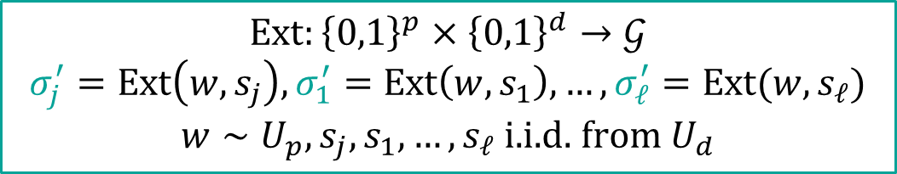
Change the Order of Inputs
$$\left(σ_{j}^{′}(y)=θ∧\min{σ_{j}^{′}\left(X_{j}\backslash y\right)>θ}\right)∧\left(\min{σ_{1}^{′}\left(X_{1}\right)}>θ\right)∧⋯∧\left(\min{σ_{ℓ}^{′}\left(X_{ℓ}\right)}>θ\right)$$
$$\text{Ev}\text{ent} A_{j}$$
$$\text{Ev}\text{ent} A_{1}$$
$$\text{Event} A_{ℓ}$$
$$\text{Ext}:{\left\{0,1\right\}}^{p}×{\left\{0,1\right\}}^{d}→𝒢$$
$$σ_{j}^{′}=\text{Ext}\left(w,s_{j}\right),σ_{1}^{′}=\text{Ext}\left(w,s_{1}\right),…,σ_{ℓ}^{′}=\text{Ext}(w,s_{ℓ})$$
$$w∼U_{p},s_{j},s_{1},…,s_{ℓ} \text{i}\text{.}\text{i}\text{.}\text{d}\text{. }\text{from} U_{d}$$

Slide 15
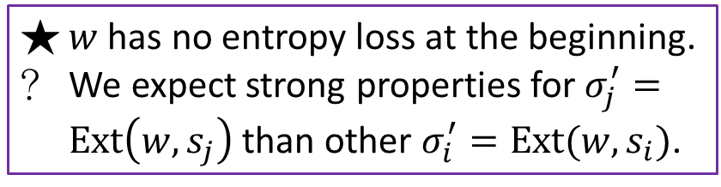
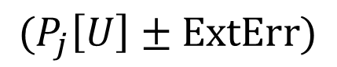
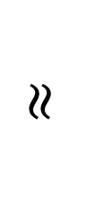
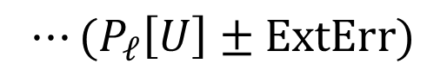
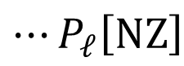

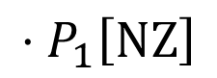
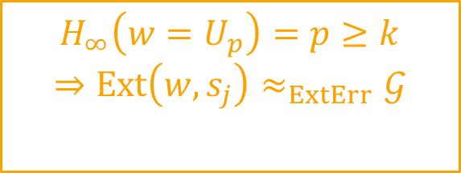
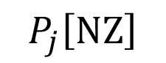
$$P_{j}\left[\text{NZ}\right]$$
$$⋅P_{1}\left[\text{NZ}\right]$$
$$⋯P_{ℓ}\left[\text{NZ}\right]$$
$$≈$$
$$(P_{j}\left[U\right]±\text{ExtErr}\text{)}$$
$$⋅(P_{1}\left[U\right]±\text{ExtErr}\text{)}$$
$$⋯(P_{ℓ}\left[U\right]±\text{ExtErr}\text{)}$$
$$H_{∞}\left(w=U_{p}\right)=p≥k$$
$$⇒\text{Ext}\left(w,s_{j}\right)≈_{ExtErr}𝒢$$
$$σ_{j}^{′}=\text{Ext}\left(w,s_{j}\right)∼𝒢$$
$w$ has no entropy loss at the beginning.
We expect strong properties for $σ_{j}^{′}=\text{Ext}\left(w,s_{j}\right)$ than other $σ_{i}^{′}=\text{Ext}(w,s_{i})$.

Slide 16

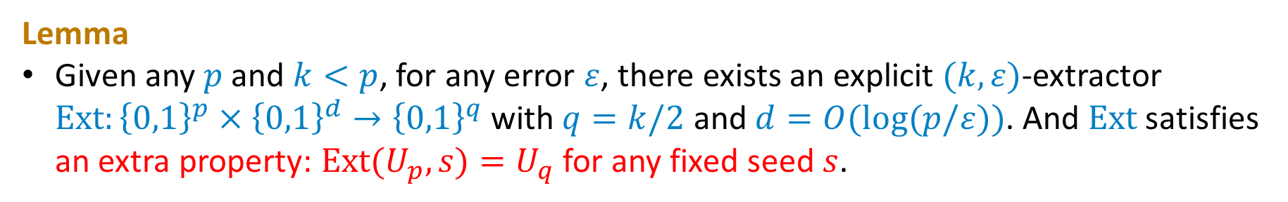
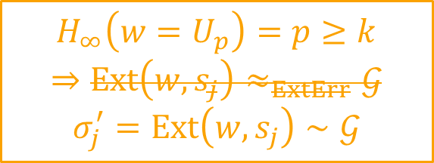
Special Extractor
$$P_{j}\left[\text{NZ}\right]$$
$$⋅P_{1}\left[\text{NZ}\right]$$
$$⋯P_{ℓ}\left[\text{NZ}\right]$$
$$≈$$
$$(P_{j}\left[U\right]±\text{ExtErr}\text{)}$$
$$⋅(P_{1}\left[U\right]±\text{ExtErr}\text{)}$$
$$⋯(P_{ℓ}\left[U\right]±\text{ExtErr}\text{)}$$
$$H_{∞}\left(w=U_{p}\right)=p≥k$$
$$⇒\text{Ext}\left(w,s_{j}\right)≈_{ExtErr}𝒢$$
$$σ_{j}^{′}=\text{Ext}\left(w,s_{j}\right)∼𝒢$$
$w$ has no entropy loss at the beginning.
We expect strong properties for $σ_{j}^{′}=\text{Ext}\left(w,s_{j}\right)$ than other $σ_{i}^{′}=\text{Ext}(w,s_{i})$.
Lemma
Given any $p$ and $k<p$, for any error $ε$, there exists an explicit $(k,ε)$-extractor $\text{Ext}:{\left\{0,1\right\}}^{p}×{\left\{0,1\right\}}^{d}→{\left\{0,1\right\}}^{q}$ with $q=k/2$ and $d=O(log⁡(p/ε))$. And $\text{Ext}$ satisfies an extra property: $\text{Ext}(U_{p},s)=U_{q}$for any fixed seed $s$.

Slide 17
Open Problems
Smaller error with optimal seed length?
Extending the result for larger $k$ (like $\sqrt{N}$) on $k$-min-wise hash?
Faster evaluation time with optimal seed length?

Slide 18
Thank you for listening!

